Slide 1
STAT/CSE 416 - Section 4
Bias and Fairness
Octavian-Vlad Murad

Slide 2
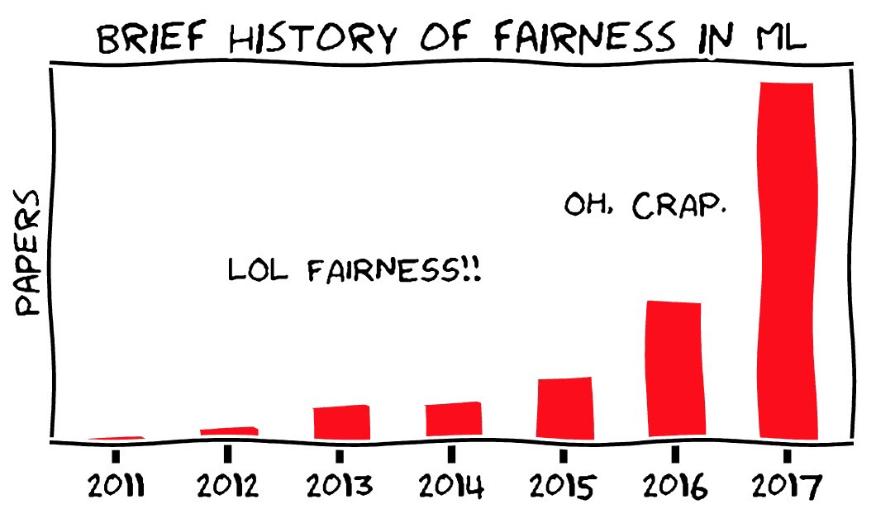
Why is this important?
ML models deployed into the world have a larger and larger impact on society.
ML models are capable of perpetuating societal biases and prejudices.
For us ML practitioners to understand when and how individual or societal harm can be caused by a ML system.
There is a great need for experts operating at the interface of policy and AI.
There is also a great need for AI experts to have a better understanding of the world around them.

Slide 3
Two Contrasting Philosophical Tenets
The goal of an algorithm is to faithfully reflect the data and optimize some metric of success at all costs.
We have a moral obligation to collect data and design systems that conform to a notion of equitable behavior. This is the view that we take.

Slide 4
Objectives
Define fairness, discrimination, and bias, particularly in the context of ML.
Provide theoretical and mathematical frameworks for understanding and analysing these concepts.
Identify how and where throughout the ML pipeline can undesired and harmful effects occur.
Come up with “fairness aware” practices that mitigate the problems identified.

Slide 5
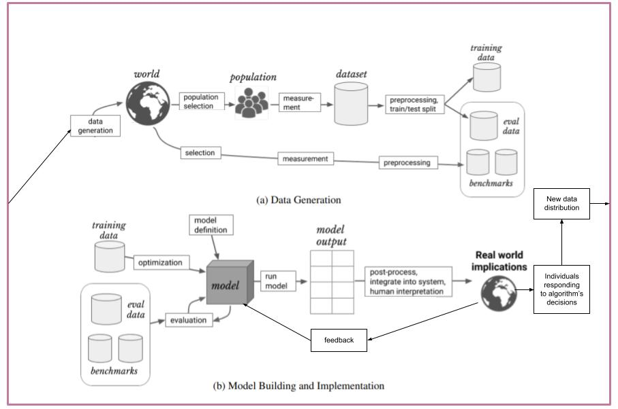
The ML Pipeline

Slide 6
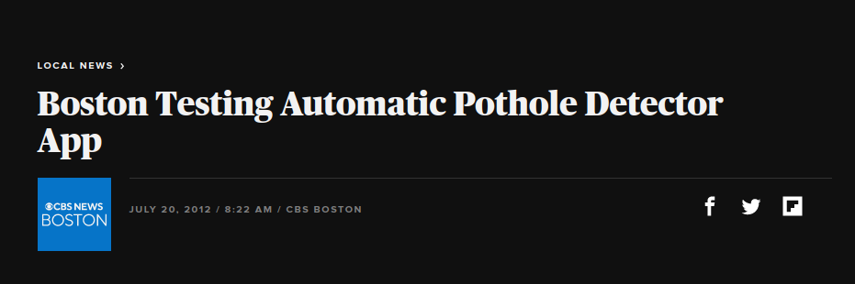
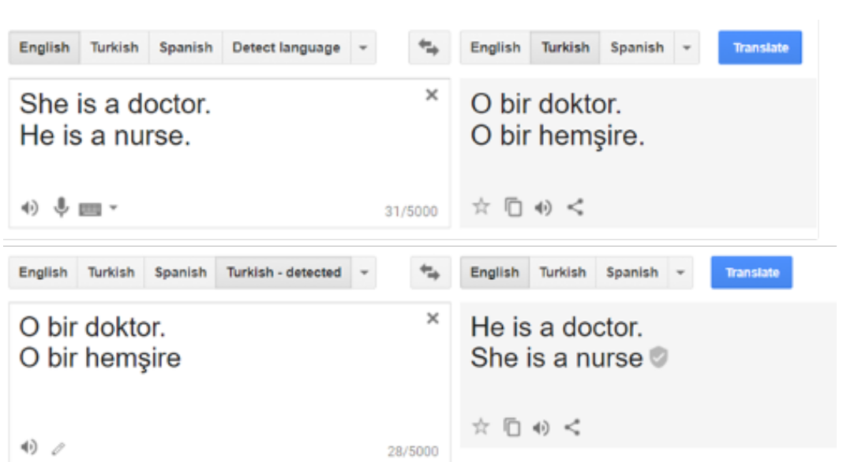
Biases and The ML Pipeline
Harm: Negative, (usually) undesired, and unintentional consequences caused by ML systems at the individual or societal level.
Allocative harms: When opportunities, life altering decisions, or resources are allocated unfairly to different groups. Direct harm caused by the algorithm making or influencing decisions or policies.
Representational harms: When people or groups are stigmatized or stereotyped. Indirect harm.
Bias: Word used to describe distinct sources of harm in an ML system
City of Boston used crowdsourcing to detect potholes and direct funds to improve road infrastructure. Due to inequalities in terms of access to technology and information, resources were allocated to richer neighborhoods. This is a type of allocative harm.
Translating from English to Turkish, then back to English injects gender stereotypes. This is a type of representational harm.

Slide 7
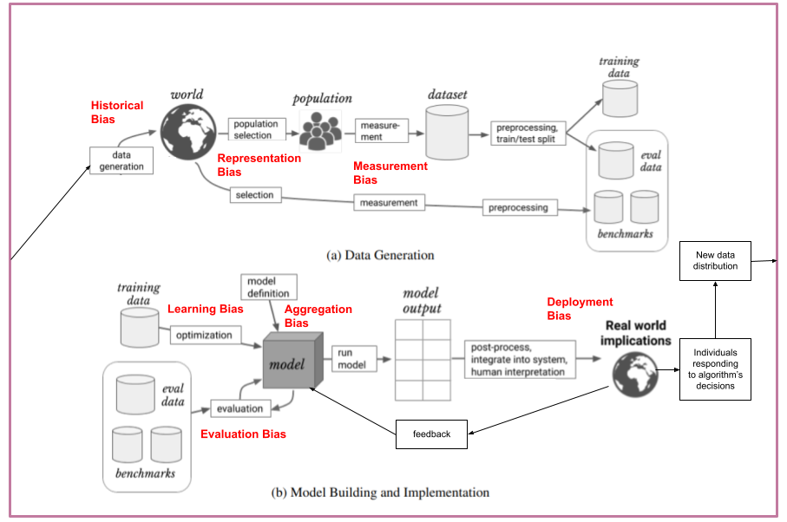
The ML Pipeline is Full of Biases

Slide 8
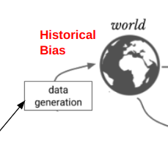
Historical Bias
Where in the ML Pipeline
Definition and considerations
Examples
How to mitigate
Underlying societal prejudices and inequalities reflected in the data.
An ML algorithm is capable in picking up these historical patterns and is very likely to perpetuate them.
Even if no other bias is present, it is often unethical to apply a model suffering from historical bias.
Predictive policing to determine which areas of the city are at a high risk of crime.
Bias towards male-as-norm pronouns when gender is unknown and occupation disparities in language models.
Adjusting the sampling procedure to account for inequalities.
Awareness from the ML practitioner and users of the ML system.

Slide 9
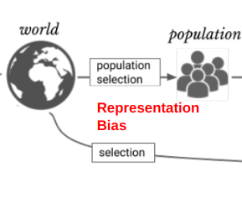
Representation Bias
Where in the ML Pipeline
Definition and considerations
Examples
How to mitigate
Occurs when the data sample underrepresents some part of the population.
Subsequent failure of the model to generalize well to the underrepresented population.
Image Datasets containing overwhelmingly more samples from the Western World.
Face recognition software being trained on mostly white faces.
Fake account detection models being trained on mostly Western names.
Understand the statistics of the population.
Adjusting the sampling procedure to account for the differences in representation.
Collect more data from the underrepresented groups.

Slide 10
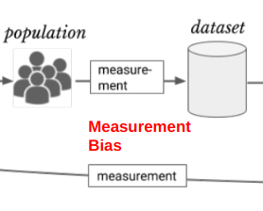
Measurement Bias
Where in the ML Pipeline
Definition and considerations
Examples
How to mitigate
Feature or labels are proxies(concrete measurements) chosen to approximate some construct(abstract, unmeasurable concepts).
Proxies could be poor reflections of the underlying concepts.
Method and accuracy of measurement could vary across groups.
Using outdated concepts or concepts changing over time.
Measurer’s subjectivism and bias.
Societal pressures in self-reporting.
Using arrest as a proxy to measure crime, re-arrest to measure recidivism.
IQ, SAT scores as proxies for intelligence. GPA as measure of academic success.
Cameras having dynamic range and color balance optimized for light skin tones.
Some methods will be discussed later(e.g. We Are All Equal Assumption).
Awareness of these issues during data collection.
Designing better proxies.

Slide 11
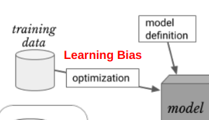
Learning Bias
Where in the ML Pipeline
Definition and considerations
Examples
How to mitigate
Arises when modeling choices amplify other biases.
Optimizing for accuracy without considering fairness as a training objective.
Applying regularization when having underrepresented groups can cause the model to ignore these data points.
Predictive policing, loan approval, job performance evaluation systems focusing solely on accuracy and profitability at the expense of more humane considerations.
Developing “fairness-aware” training objectives. (more on this later).
Not optimizing accuracy at all costs.

Slide 12
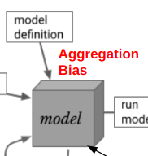
Aggregation Bias
Where in the ML Pipeline
Definition and considerations
Examples
How to mitigate
Arises when a one-size-fits-all model is used for data in which different groups should be handled differently.
Assumption that the true function mapping inputs to outputs is consistent across subpopulations.
Language models ignoring group specific language usage(slang, idioms) pertaining to certain groups.
Use more complex models.
Use models that are better at identifying and modeling distributions with subpopulations.
Collect more data from underrepresented subpopulations.

Slide 13
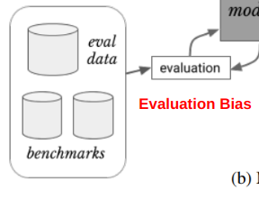
Evaluation Bias
Where in the ML Pipeline
Definition and Considerations
Examples
How to mitigate
Representation and Measurement Biases applied to the test data.
Using “fairness-unaware” metrics to evaluate models(similar to learning biases focusing solely on accuracy, but applied to testing).
Facial recognition algorithms performing terribly on dark-skinned women.
Predictive policing focusing on accuracy, but ignoring disparities in false positives.
Sample better test datasets.
Develop “fairness-aware” evaluation metrics(more on this later).

Slide 14
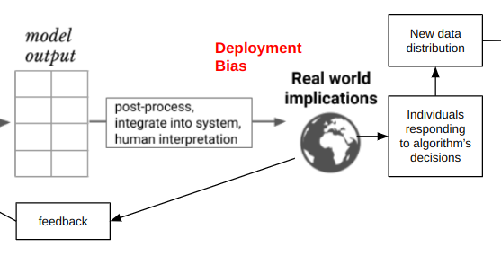
Deployment Bias
Where in the ML Pipeline
Definition and considerations
Examples
How to mitigate
Mismatch between a model’s intended and actual use.
Ignoring the fact that models do not exist in a void, but in a complicated socio-economic context.
The predictions of a model will alter the state of the world and will change the data distribution it is trying to model, creating negative feedback loops and self-fulfilling prophecies.
Lack of interpretability of a model’s output.
Judges sometimes use crime prediction software to determine sentence length.
Predictive policing causes more policing in high risk areas, further validating the model’s prediction and generating more biased data.
Traffic congestion software suggest alternative route which will then become congested.
Neural Networks are black boxes and their decisions are opaque.
Awareness and a basic understanding of how ML works for the people using and being affected by the algorithms.
Refusing to deploy models due to ethical concerns regarding reinforcing prejudice.

Slide 15
Study Case #1: Work Performance Evaluation
Suppose we are interested in evaluating the job performance of employees in our tech company. We take into account:
the employee’s work experience(within and outside our company) and their college GPA as a proxy for their ability.
their lack of paid time-off as a proxy for hard work.
their responses to a work satisfaction questionnaire as a proxy for their commitment to the company.
we use a large neural network(uninterpretable black-box model) to aid our decisions.
What biases do we expect to perpetuate?

Slide 16
Study Case #2: Amazon Same-Day Delivery
Suppose we work at Amazon and are creating an algorithm to predict in which neighborhoods would it be profitable to have same-day delivery. We take into account:
the quality of the transportation infrastructure in the neighborhood as a proxy for low distribution cost.
the number of reported stolen packages as a proxy for incurred losses.
the number of order placed in that neighborhood as a proxy for income.
What biases do we expect to perpetuate?

Slide 17
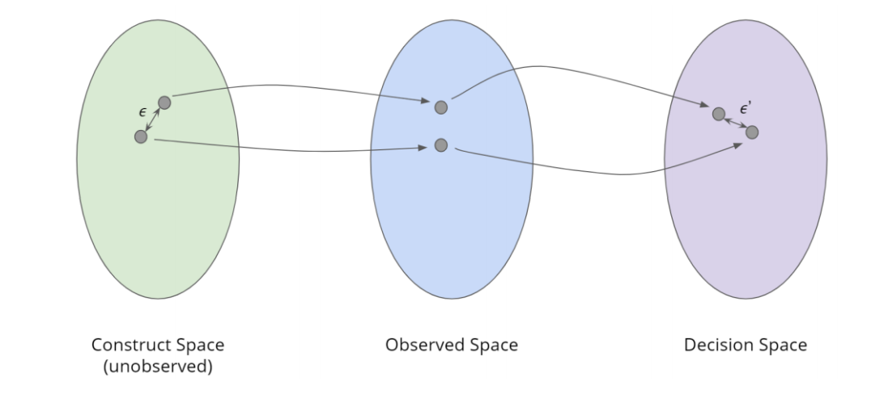
A Theoretical Framework for Fairness
Think of a ML algorithm as a collection of transformations between three spaces:
Construct space: unobserved; for each person in the population, we have a set of abstract constructs that we cannot measure directly, but which we consider relevant for the decisions we want to make.
Observed space: observed; for each person in the population, we have measurements of proxies devised to approximate the constructs.
Decision space: for each person in the population, we a corresponding decision.
measurement
prediction

Slide 18
Example 1
Predicting college performance:
Construct space | Intelligence | Success in High-school |  | Creativity
Observed space | IQ test score | HS GPA | Class Attendance | Essay Score
Decision space | College GPA(continuous)
measurement
prediction

Slide 19
Example 2
Predictive Policing:
Construct space | Propensity to Commit Crime |  |  | Risk-Averseness
Observed space | Family Crime History | Criminal Record |  | Age
Decision space | Will commit a crime/Will not commit a crime(binary)
measurement
prediction

Slide 20
Types of fairness
There are many different methods of measuring fairness and the authors of the three spaces scheme claim they all can be understood and analysed within their framework.
They identify two main types of fairness:
Individual Fairness: For any two people, small distance in CS ⇒ small distance in DS.
Group Fairness: For any two groups of people, there is no significant separation between where the two groups get mapped in DS.
Unfortunately, the two notions of fairness cannot be satisfied at the same time.
measurement
prediction

Slide 21
Worldviews
However, Individual Fairness and Group Fairness can separately be satisfied when certain assumptions(a.k.a worldviews or axioms) are made about the spaces and the transformations between them. These two, incompatible assumptions are:
What you see is what you get.
Structural Bias + We are all equal.
measurement
prediction

Slide 22
What You See is What You Get
We assume that the observed space represents the construct space faithfully. That is, two groups are separated in the observed space ⇔ there is a relevant, non-discriminatory difference in their characteristics given the decision at hand.
Individual Fairness can be satisfied under this assumption.
Group Fairness cannot be satisfied under this assumption, as it would result in individual discrimination against the people who perform better.
measurement
prediction

Slide 23
Structural Bias + We Are All Equal
We Are All Equal: For any two groups of people, there is no significant separation between the groups in CS. That is, we all have equal innate, relevant skills regardless of membership to any particular group.
Structural Bias: Any separation occurring when we transform two groups between the CS and OS is due to structural bias, an umbrella term for biases pertaining to data generation and collection such as historical, representation, or measurement biases.
measurement
prediction

Slide 24
Structural Bias + We Are All Equal
Individual Fairness cannot be satisfied under this assumption, as it would result in group discrimination.
Group Fairness can be satisfied under this assumption.
measurement
prediction

Slide 25
Worldviews Summary
Worldview | Assumptions | Can Achieve | Can Cause
WYSIWYG | OS faithfully represents CS | Individual Fairness | Group Discrimination
SB + WAAE | Differences in OS are due to discrimination + No difference between groups in CS | Group Fairness | Individual Discrimination

Slide 26
Some Definitions of Fairness
Type of Fairness | Definition | Math | Worldview | Example
Fairness through Unwareness | Decisions are not based on group membership. | For any group g: P(Y|G=g) = P(Y) | WYSIWYG | Job reviews where we don’t look at the employee’s gender and expect no differences in evaluations between genders.
Statistical Parity | Decisions should be the same when conditioning on group membership | For any groups g_{i}, g_{j} : P(Y|G=g_{i}) = P(Y|G=g_{j}) | SB + WAAE | College admissions using racial quotas.
Equal Opportunity | False negative rates (or true positive) should be equal across groups. | For any groups g_{i}, g_{j} : P(Ŷ=- | G=g_{i}, Y=+) = P(Ŷ=- |G=g_{j}, Y=+) | SB + WAAE | Job applications where we want the rate of women and men getting rejected, despite being qualified, to be equal.
Predictive Equality | False positive rates (or true negative) should be equal across groups. | For any groups g_{i}, g_{j} : P(Ŷ=+ | G=g_{i}, Y=-) = P(Ŷ=+ |G=g_{j}, Y=-) | SB + WAAE | Job applications where we want the rate of women and men getting accepted, despite being not being qualified, to be equal.

Slide 27
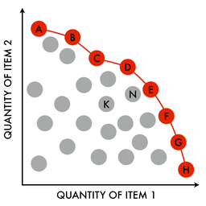
Trade-offs / Pareto Frontier/ ”Fairness Aware” Methods
There is an inherent tradeoff between model accuracy and model fairness.
The “Pareto Frontier” describes a group of models where we cannot increase fairness without sacrificing accuracy and vice-versa. No modification can be made to increase both. This would be “Fairness Aware” evaluation.
We can also create “Fairness Aware” models by including a Fairness Term in the error function used to train our models. For example, we could have a Fairness Term which encourages diversity over the inputs which get labelled as positive.

Slide 28
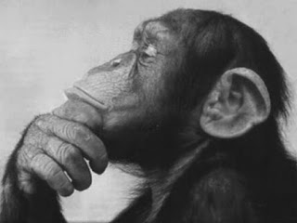
Discuss the Pros and Cons of Automatic or ML Assisted Decision Making vs Purely Human Decision Making.

Slide 29
Questions

